Slide 1


Slide 2









Initiate Solar
$
?
Why Us?
Discovery
Why Solar?
Us vs Them
FAQ
Next Steps
Your System
Our company wants to help make the earth a better place. We think about how every decision we make affects the earth and we are always looking for ways to be more green and eco-friendly. We hope that going solar is just the first step you take in making eco-friendly decisions.

Slide 3
Education
$
?
Why Us?
Discovery
Why Solar?
Us vs Them
FAQ
Next Steps
Your System
We are here to educate you about solar energy. We want you to be confident in your decision-making. Our goal is to have the most knowledgeable and satisfied customers so we can make a better Earth together.

Slide 4
Selection
$
?
Why Us?
Discovery
Why Solar?
Us vs Them
FAQ
Next Steps
Your System
We are a solar company that provides a variety of panels and products to fit every home. We have the ability to provide the best solar solution for each family we work with.

Slide 5
Installation
$
?
Why Us?
Discovery
Why Solar?
Us vs Them
FAQ
Next Steps
Your System
We have a network of local installers who are licensed and have the right licenses to do your project properly. They use top-quality equipment, so you're sure to be happy with the results.

Slide 6

Discovery

Slide 7
Have you looked into going solar before?
Next Question
$
?
Why Us?
Discovery
Why Solar?
Us vs Them
FAQ
Next Steps
Your System

Slide 8
Why have you not gone solar yet?
Next Question
PREVIOUS QUESTION
$
?
Why Us?
Discovery
Why Solar?
Us vs Them
FAQ
Next Steps
Your System

Slide 9
Are you more interested in saving money, using more power, or going green?
Next Question
PREVIOUS QUESTION
$
?
Why Us?
Discovery
Why Solar?
Us vs Them
FAQ
Next Steps
Your System

Slide 10
Do you anticipate any changes in energy consumption in the near future?
Next Question
PREVIOUS QUESTION
$
?
Why Us?
Discovery
Why Solar?
Us vs Them
FAQ
Next Steps
Your System

Slide 11
How do you typically pay your Federal taxes each year?
Next Question
PREVIOUS QUESTION
$
?
Why Us?
Discovery
Why Solar?
Us vs Them
FAQ
Next Steps
Your System

Slide 12
What are your biggest goals and concerns with going solar?
See How Solar Helps
PREVIOUS QUESTION
$
?
Why Us?
Discovery
Why Solar?
Us vs Them
FAQ
Next Steps
Your System

Slide 13

Why Solar?

Slide 14
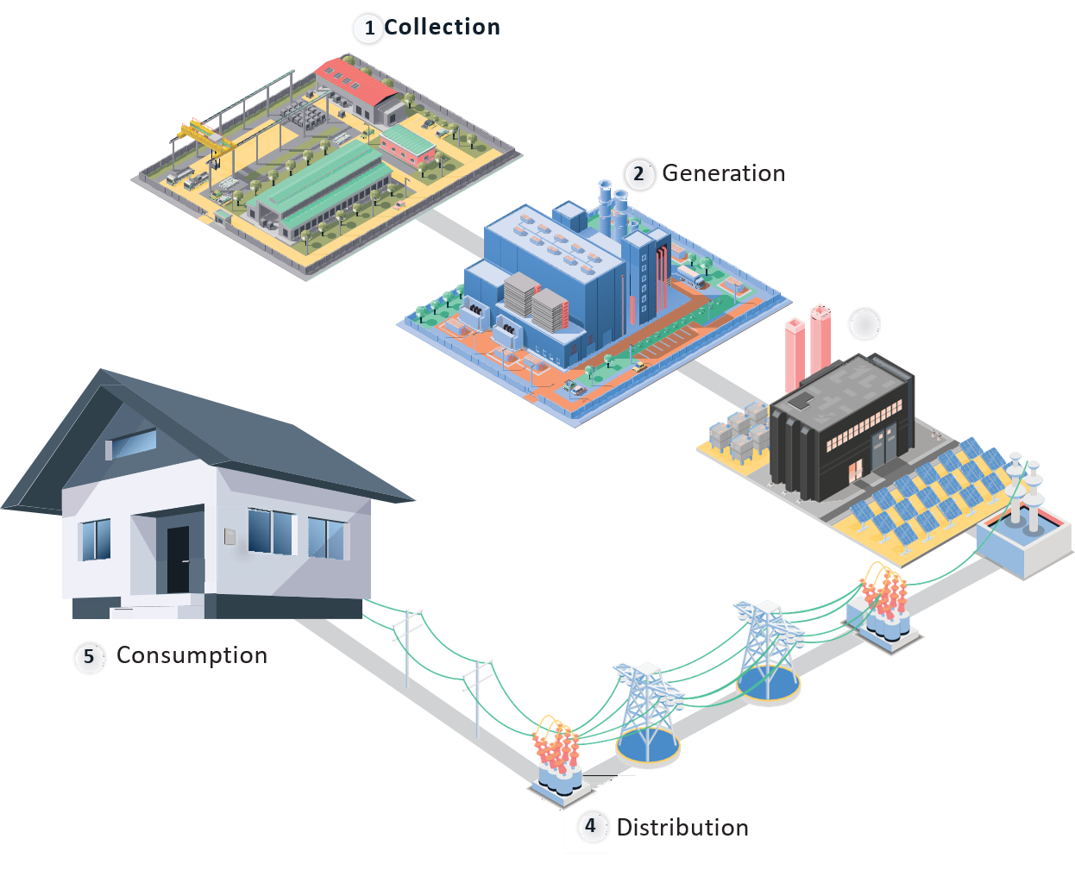
Traditional Energy
Expensive Fees
Learn More
$
?
Why Us?
Discovery
Why Solar?
Us vs Them
FAQ
Next Steps
Your System
Retail: TXU, Champion, Amigo
Traditional energy goes through an inefficient journey as it’s shipped to your house.
This is a major contributing factor to why utility rates are so high.
It’s an outdated business model.
Oncore

Slide 15
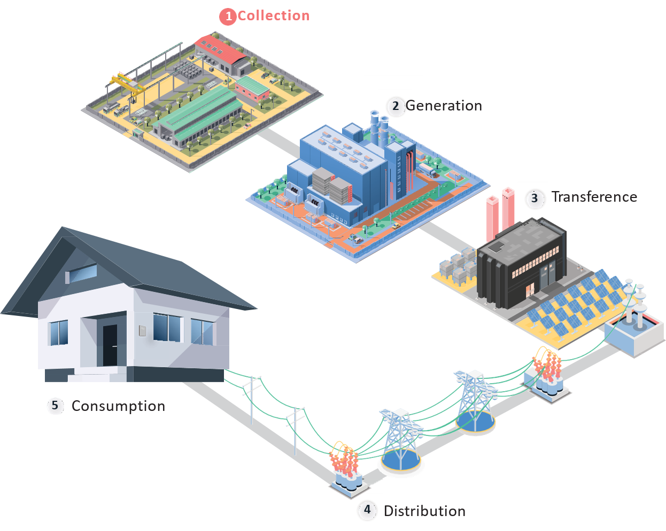
Traditional Energy
Collection
<
>
$
?
Why Us?
Discovery
Why Solar?
Us vs Them
FAQ
Next Steps
Your System
Utility Breakdown
Utilities collect power from resources like gas, oil etC
Electricity Generation
DWR Bond Charge
Transmission
Distribution
Public Purpose Programs
Nuclear Decommissioning Revenue Adjustment
Competition Transition Charge
Local Generation Charge Reliability Services
TRAC

Slide 16
Traditional Energy
Generation
<
>
$
?
Why Us?
Discovery
Why Solar?
Us vs Them
FAQ
Next Steps
Your System
Utility Breakdown
The utility company converts those resources into energy
Electricity Generation
DWR Bond Charge
Transmission
Distribution
Public Purpose Programs
Nuclear Decommissioning Revenue Adjustment
Competition Transition Charge
Local Generation Charge Reliability Services
TRAC

Slide 17
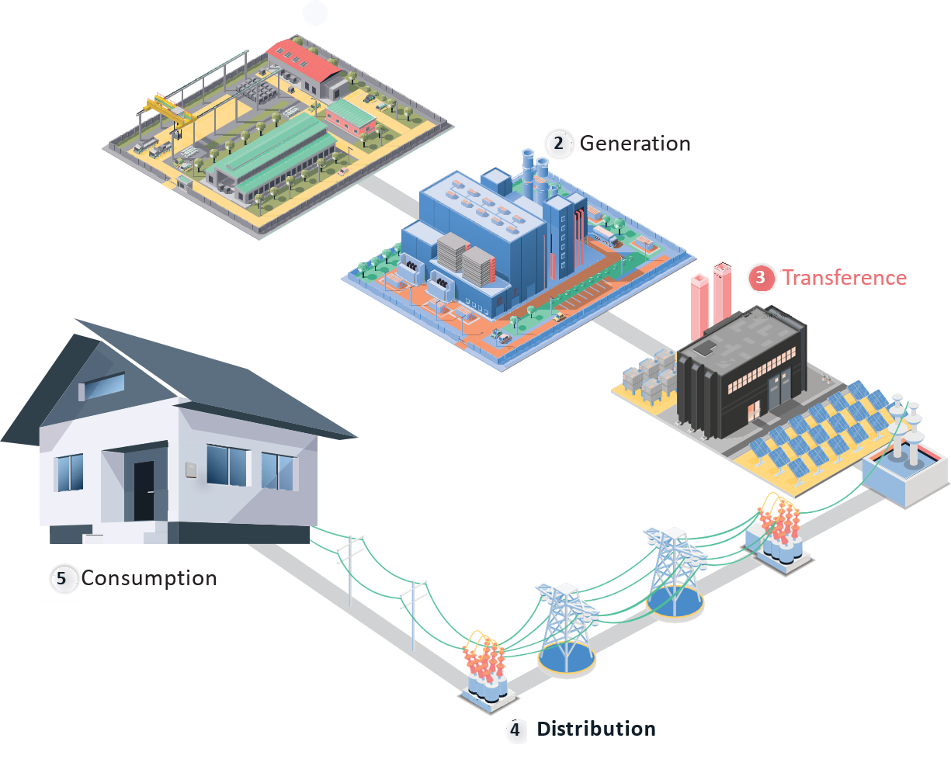
Traditional Energy
Transference
<
>
$
?
Why Us?
Discovery
Why Solar?
Us vs Them
FAQ
Next Steps
Your System
Utility Breakdown
They then transfer that generated energy to the substation
Electricity Generation
DWR Bond Charge
Transmission
Distribution
Public Purpose Programs
Nuclear Decommissioning Revenue Adjustment
Competition Transition Charge
Local Generation Charge Reliability Services
TRAC

Slide 18
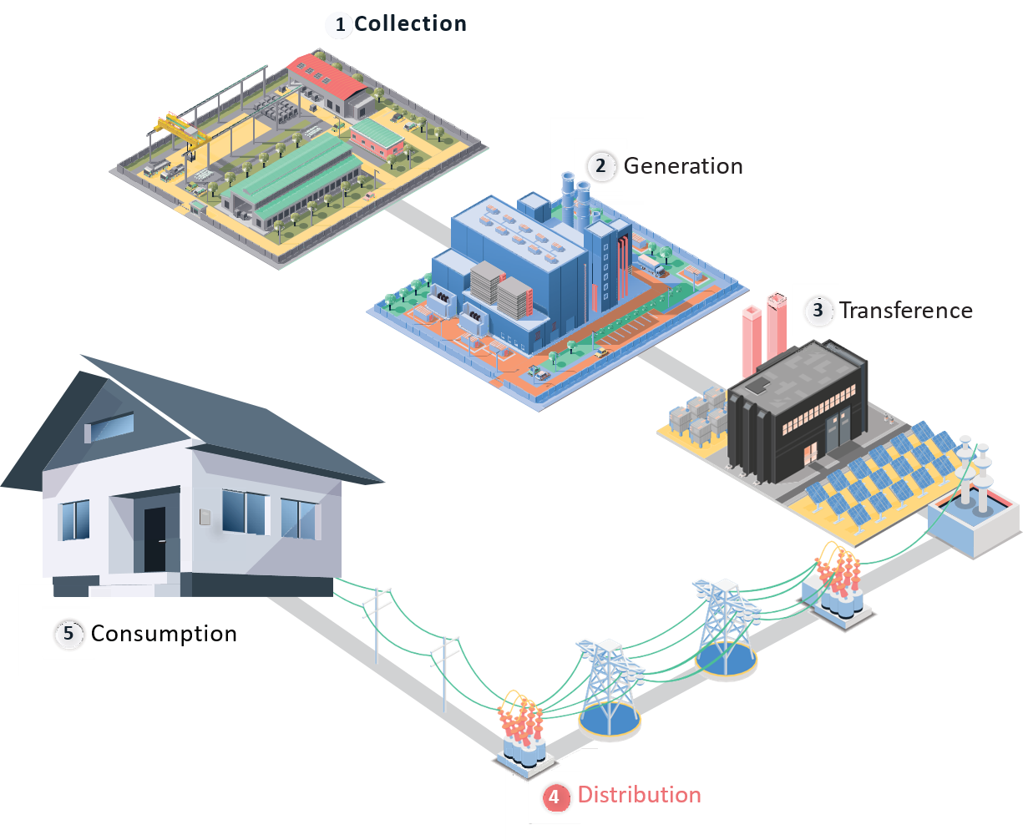
Traditional Energy
Distribution
<
>
$
?
Why Us?
Discovery
Why Solar?
Us vs Them
FAQ
Next Steps
Your System
Utility Breakdown
The power travels sometimes
hundreds of miles to neighborhood
Electricity Generation
DWR Bond Charge
Transmission
Distribution
Public Purpose Programs
Nuclear Decommissioning Revenue Adjustment
Competition Transition Charge
Local Generation Charge Reliability Services
TRAC

Slide 19
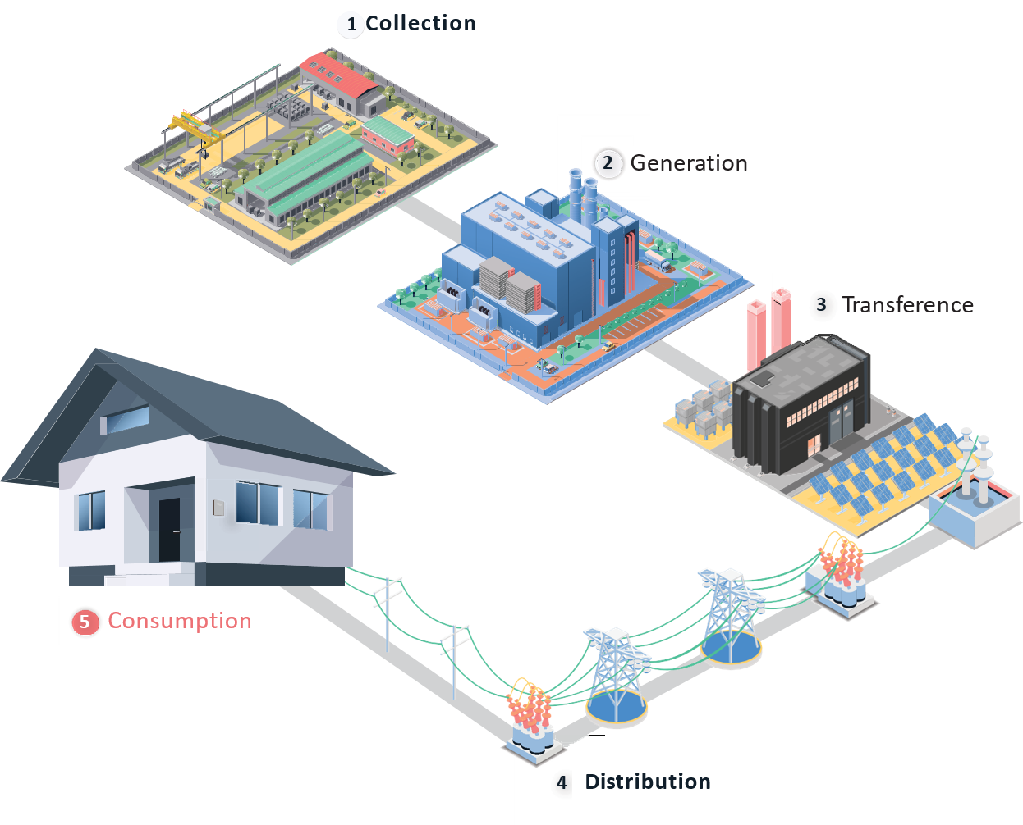
Traditional Energy
Consumption
<
>
$
?
Why Us?
Discovery
Why Solar?
Us vs Them
FAQ
Next Steps
Your System
Utility Breakdown
It finally finishes its journey to power your home
Electricity Generation
DWR Bond Charge
Transmission
Distribution
Public Purpose Programs
Nuclear Decommissioning Revenue Adjustment
Competition Transition Charge
Local Generation Charge Reliability Services
TRAC

Slide 20

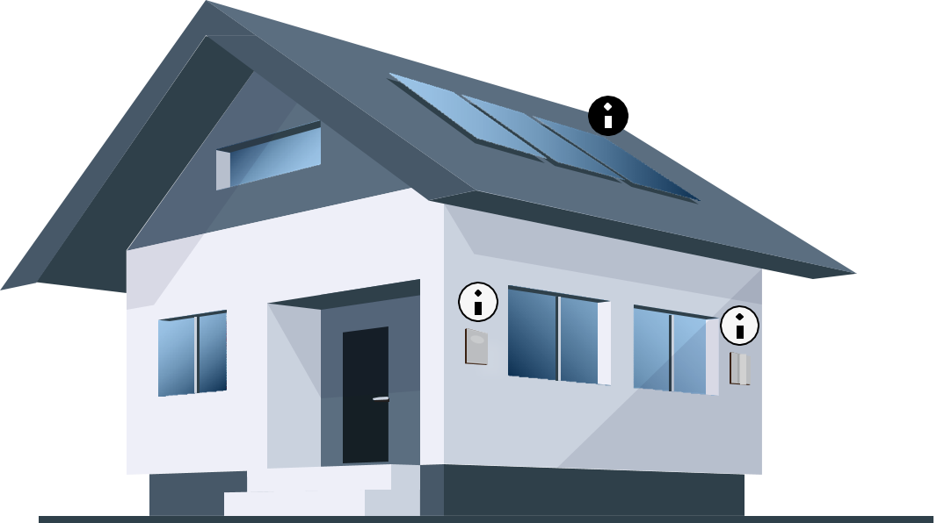
Solar Energy
So Simple
<
>
$
?
Why Us?
Discovery
Why Solar?
Us vs Them
FAQ
Next Steps
Your System
It’s local!
Solar means easy, clean, power! Solar means saving money.
You now can avoid the high fees and costs from utilities associated with dragging your power across the grid.
You pull your power straight from the roof and reap all the benefits.
Solar panels
Solar panels capture natural sunlight and generate an electric current that is transported through wires to the inverter.
Solar Breakdown
Solar Bill
Grid Connection Charge

Slide 21
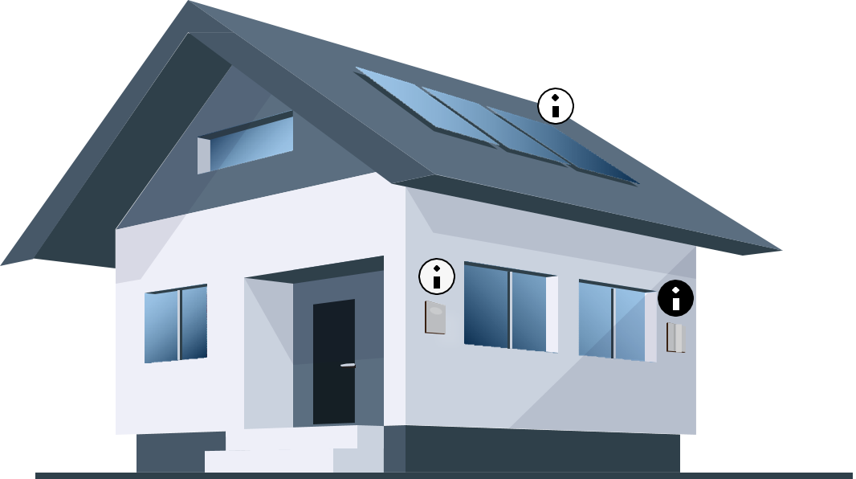
Solar Energy
So Simple
<
>
$
?
Why Us?
Discovery
Why Solar?
Us vs Them
FAQ
Next Steps
Your System
It’s local!
Solar means easy, clean, power! Solar means saving money.
You now can avoid the high fees and costs from utilities associated with dragging your power across the grid.
You pull your power straight from the roof and reap all the benefits.
Inverter
It captures the direct current and converts it into alternating current
which is the type of electrical current we use in our homes.
Solar Breakdown
Solar Bill
Grid Connection Charge

Slide 22

Solar Energy
So Simple
Learn More
<
>
$
?
Why Us?
Discovery
Why Solar?
Us vs Them
FAQ
Next Steps
Your System
Net meter
It’s local!
Solar means easy, clean, power! Solar means saving money.
You now can avoid the high fees and costs from utilities associated with dragging your power across the grid.
You pull your power straight from the roof and reap all the benefits.
After the electricity is converted to alternating current, this is transported to the home's electrical panel. Your new meter will be installed by your electric service provider. The meter will be monitoring solar production and electricity consumption.
Solar Breakdown
Solar Bill
Grid Connection Charge

Slide 23
Us vs. Them
$

Slide 24
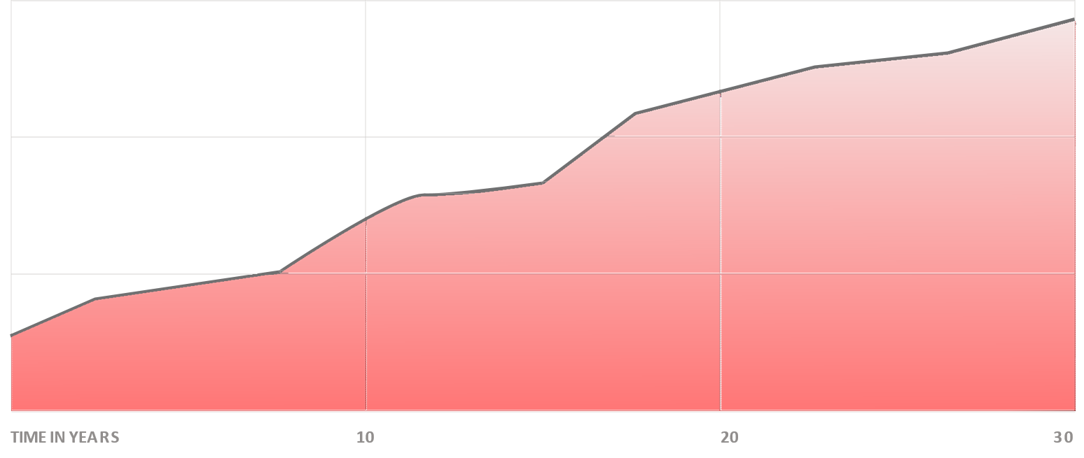


The Cost of Not Going Solar
$
?
Why Us?
Discovery
Why Solar?
Us vs Them
FAQ
Next Steps
Your System
Utility rates have increased an average of 6 % per year over the last 20 years.
Utility rates have increased an average of 6% per year over the last 20 years, and the data is showing electricity rates will continue to rise for years to come.

Slide 25
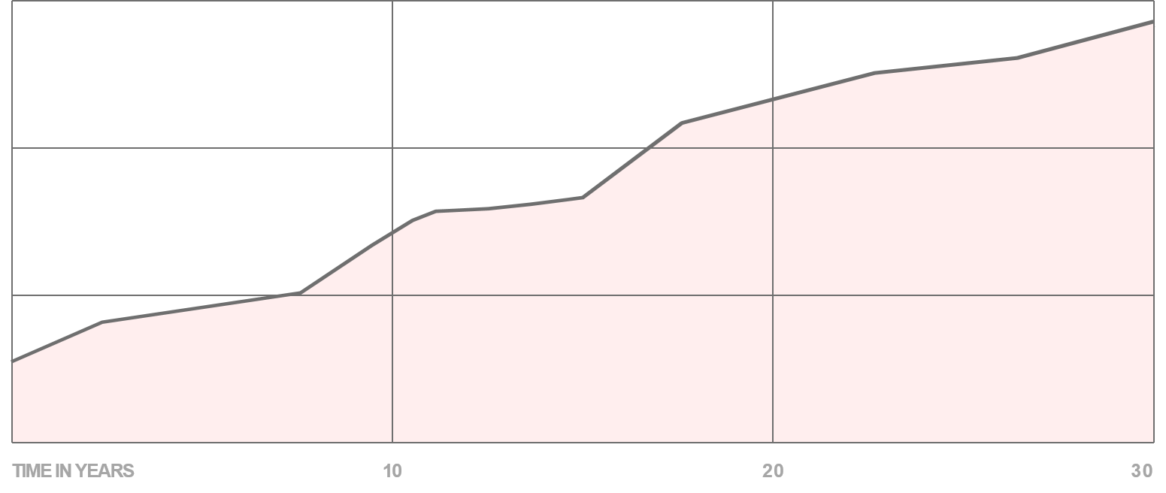
Take Control of Your Energy Costs
$
?
Why Us?
Discovery
Why Solar?
Us vs Them
FAQ
Next Steps
Your System
When you go solar, your bill is flat, predictable, and has an end in sight.
Utility rates have increased an average of 6% per year over the last 20 years, and the data is showing electricity rates will continue to rise for years to come.

Slide 26



Start Saving Money Day 1
$
?
Why Us?
Discovery
Why Solar?
Us vs Them
FAQ
Next Steps
Your System
When you go solar, your bill is flat, predictable, and has an end in sight.
Utility rates have increased an average of 6% per year over the last 20 years, and the data is showing electricity rates will continue to rise for years to come.

Slide 27
FAQ
?

Slide 28




Cost
$
?
Why Us?
Discovery
Why Solar?
Us vs Them
FAQ
Next Steps
Your System
WHAT ARE THE UPFRONT COSTS?
$0
There are absolutely zero upfront costs when going solar. You will not pay a penny until your solar system is installed, activated, producing your power, and replacing your old utility bill, guaranteed.
CREDITS AND REBATES
HOW DO I QUALIFY?
25
COST
MAINTENANCE
GUARANTEE
MOVING
N.E.M

Slide 29

Cost
30%
$
?
Why Us?
Discovery
Why Solar?
Us vs Them
FAQ
Next Steps
Your System
WHAT ARE THE UPFRONT COSTS?
CREDITS AND REBATES
HOW DO I QUALIFY?
Investment Tax Credit
25
COST
MAINTENANCE
GUARANTEE
MOVING
N.E.M

Slide 30
Cost
650
$
?
Why Us?
Discovery
Why Solar?
Us vs Them
FAQ
Next Steps
Your System
WHAT ARE THE UPFRONT COSTS?
CREDITS AND REBATES
HOW DO I QUALIFY?
Credit Score
25
COST
MAINTENANCE
GUARANTEE
MOVING
N.E.M

Slide 31
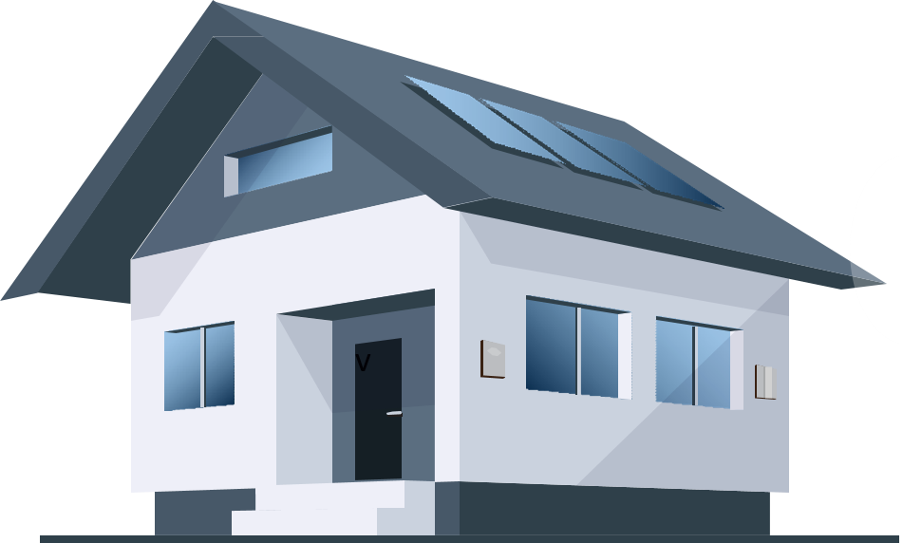
Warranties & Maintenance
$
?
Why Us?
Discovery
Why Solar?
Us vs Them
FAQ
Next Steps
Your System
1
FULL MAINTENANCE, WARRANTY, AND SERVICING INCLUDED
Peace of mind is paramount, although issues are very rare
ROOF
2
We fully insure your roof for 10 years
MANUFACTURER WARRANTY
3
25 year workmanship warranty
PRODUCTION GUARANTEE
4
Industry best 25 year production guarantee
25
COST
MAINTENANCE
GUARANTEE
MOVING
N.E.M

Slide 32

If your system drops below what we say it’s going to produce, we will write you a check for the difference, guaranteed for 25 years.
$
?
Why Us?
Discovery
Why Solar?
Us vs Them
FAQ
Next Steps
Your System
25
COST
MAINTENANCE
GUARANTEE
MOVING
N.E.M

Slide 33
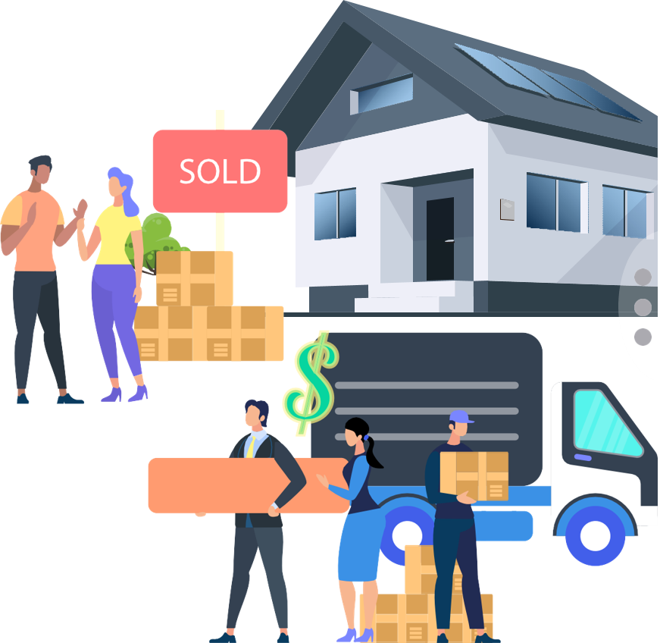
What Happens If I Move?
$
?
Why Us?
Discovery
Why Solar?
Us vs Them
FAQ
Next Steps
Your System
You have a couple options when you move.
Transfer solar bill to the new homeowner
Switch the name on the bill, just like you would with your regular utility bill.
25
COST
MAINTENANCE
GUARANTEE
MOVING
N.E.M

Slide 34
What Happens If I Move?
$
?
Why Us?
Discovery
Why Solar?
Us vs Them
FAQ
Next Steps
Your System
You have a couple options when you move.
Roll the remainder of the system into your home value
You can also pay off the remainder of your agreement, and bake that value directly into the price of your home meaning prospective buyers won’t worry about an electricity bill at all.
Finance/Purchase Only
25
COST
MAINTENANCE
GUARANTEE
MOVING
N.E.M

Slide 35
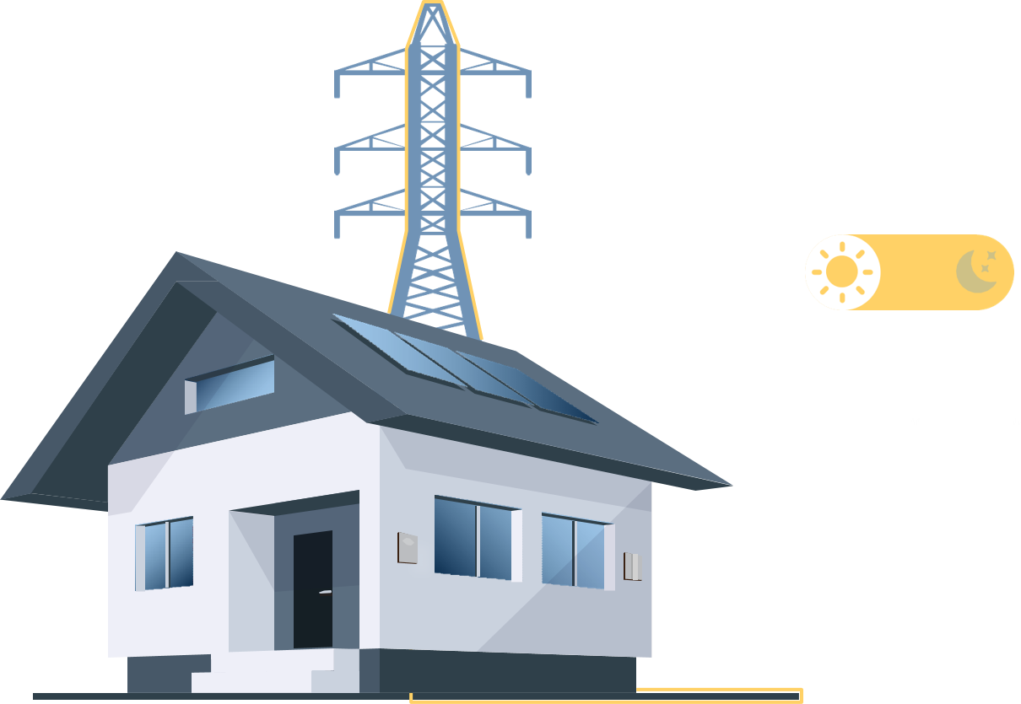
N.E.M
$
?
Why Us?
Why Us?
Discovery
Why Solar?
Us vs Them
FAQ
Next Steps
Your System
NET ENERGY METERING
During the day, your system produces energy which is tracked through your smart meter. You receive credits from the utility company whenever you produce more energy than you consume.
.
25
COST
MAINTENANCE
GUARANTEE
MOVING
N.E.M

Slide 36

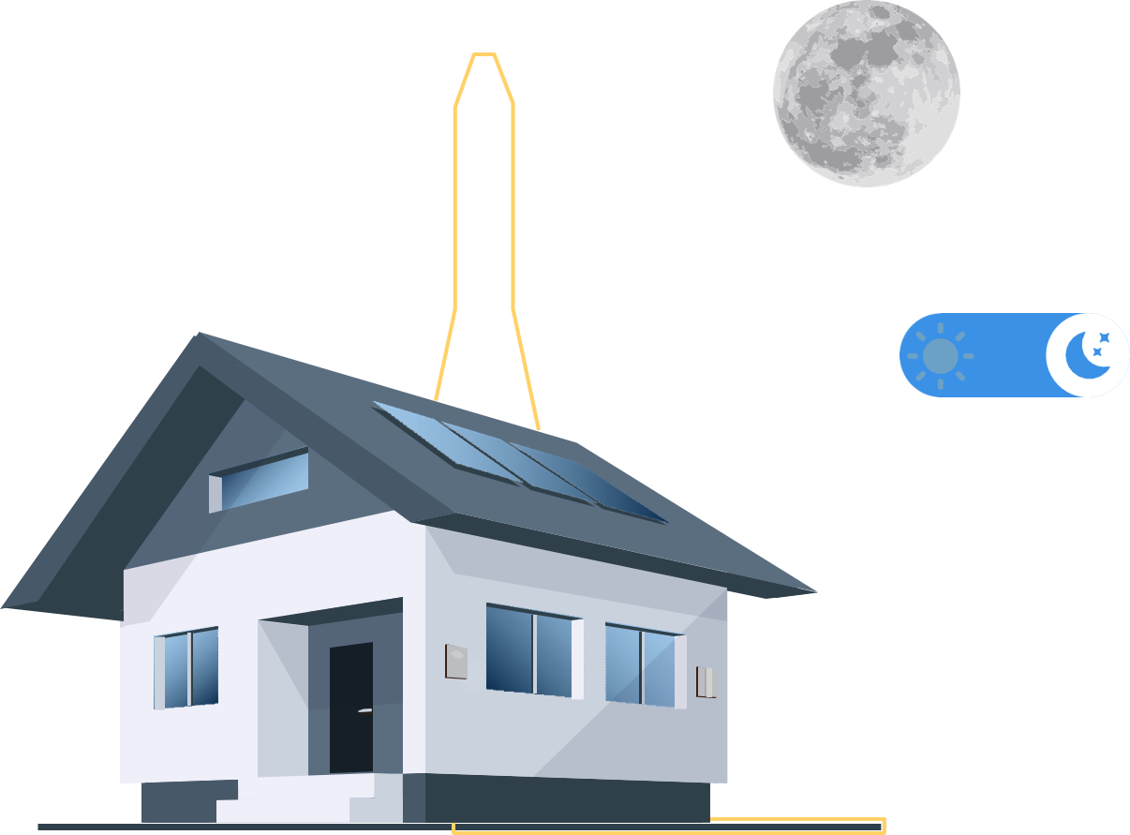
N.E.M
$
?
Why Us?
Discovery
Why Solar?
Us vs Them
FAQ
Next Steps
Your System
NET ENERGY METERING
During the night, your net-meter will provide your home the overproduced solar electricity that you sent out to the grid due to over production created during the day.a
25
COST
MAINTENANCE
GUARANTEE
MOVING
N.E.M

Slide 37

Next Steps

Slide 38

$
?
Why Us?
Discovery
Why Solar?
Us vs Them
FAQ
Next Steps
Your System
TODAY
Select System
TODAY
Get Qualified
TODAY
Success Checklist
YOU
US
THEM
1-7 DAYS
Site Audit
2-5 DAYS
Confirm Plans
Qualify & Save
1-3 WEEKS
Permitting
1. Step, you will have a customized system for your home.
2. Step, is to verify as a homeowner you have the requirements to qualify for the program.
3. Step is to approve the documents to begin the process.
1 DAY
Install
UP TO 1 MONTH
Inspection
UP TO 1 MONTH
Activation
FOREVER
Save Money

Slide 39
$
?
Why Us?
Discovery
Why Solar?
Us vs Them
FAQ
Next Steps
Your System
TODAY
Select System
TODAY
Get Qualified
TODAY
Success Checklist
YOU
US
THEM
1-7 DAYS
Site Audit
2-5 DAYS
Confirm Plans
We Take Care of The Heavy Lifting
Our team will come to your home to obtain exact measurements and to make a study of the shadow generated around your house.
Then, we will confirm the final plans generated for the client's approval. These will be sent to the local mayor's office to obtain the permits.
Once we have the permits from the mayor's office we can schedule a date for the installation of the panels.
1-3 WEEKS
Permitting
1 DAY
Install
UP TO 1 MONTH
Inspection
UP TO 1 MONTH
Activation
FOREVER
Save Money

Slide 40
$
?
Why Us?
Discovery
Why Solar?
Us vs Them
FAQ
Next Steps
Your System
TODAY
Select System
TODAY
Get Qualified
TODAY
Success Checklist
YOU
US
THEM
1-7 DAYS
Site Audit
2-5 DAYS
Confirm Plans
We Work With the City and Utility to Activate
The last two steps would be, passing the inspection with the local mayor's office and electric company and the last step is to receive the date of the day when we can activate the operation of the system.
1-3 WEEKS
Permitting
1 DAY
Install
UP TO 1 MONTH
Inspection
UP TO 1 MONTH
Activation
FOREVER
Save Money

Slide 41
Your custom proposal is here
See My System
Customer Satisfaction Form
$
?
Why Us?
Discovery
Why Solar?
Us vs Them
FAQ
Next Steps
Your System

